Slide 1
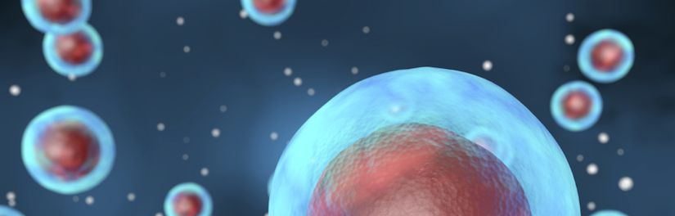
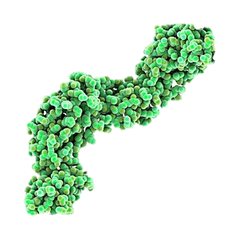
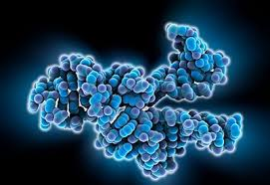
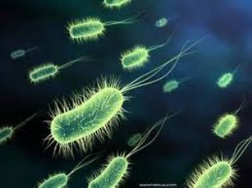
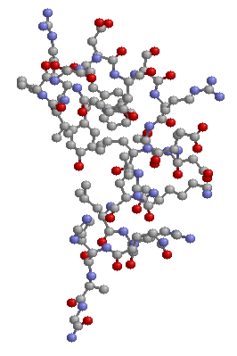
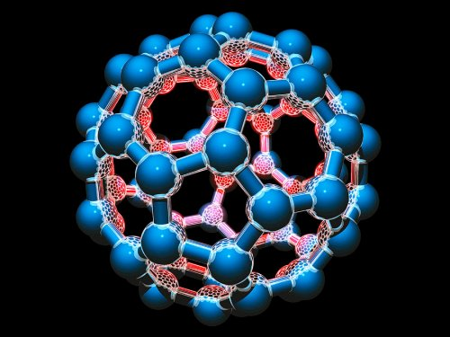
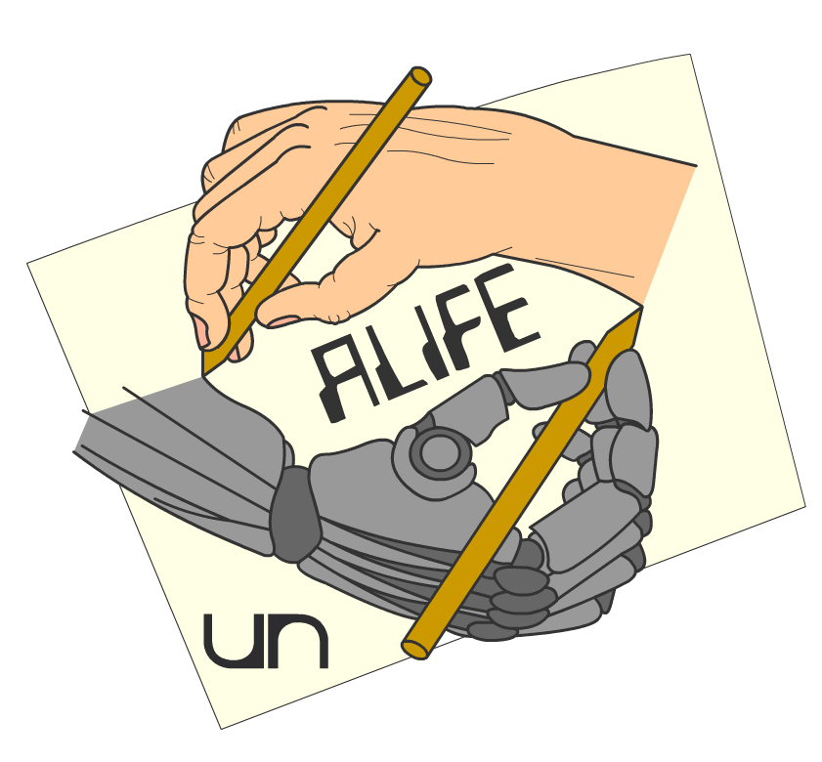

Artificial Chemistries
The essence of life
Daniel Rodríguez Cárdenas
Carlos Andrés Sierra
Alife research group,
Universidad Nacional,
Bogotá, Colombia.
Notes:
© Copyright Showeet.com – Free PowerPoint Templates

Slide 2
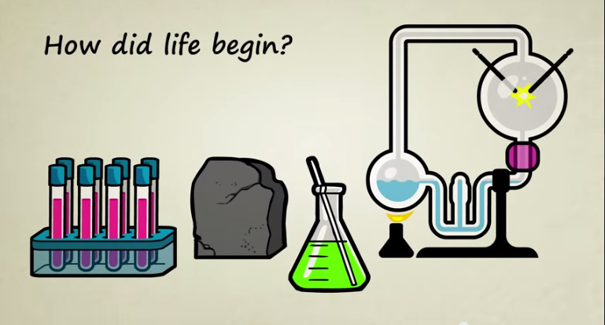
A big question

Slide 3
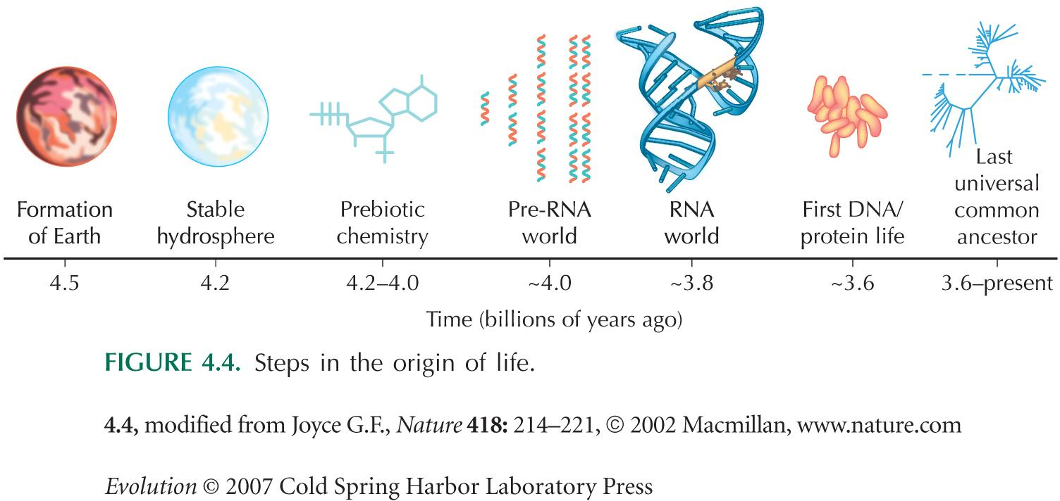
Primordial steps

Slide 4
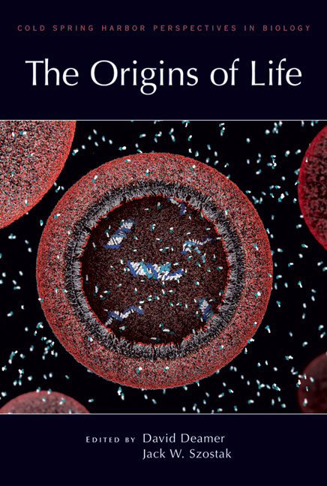
Some references

Slide 5
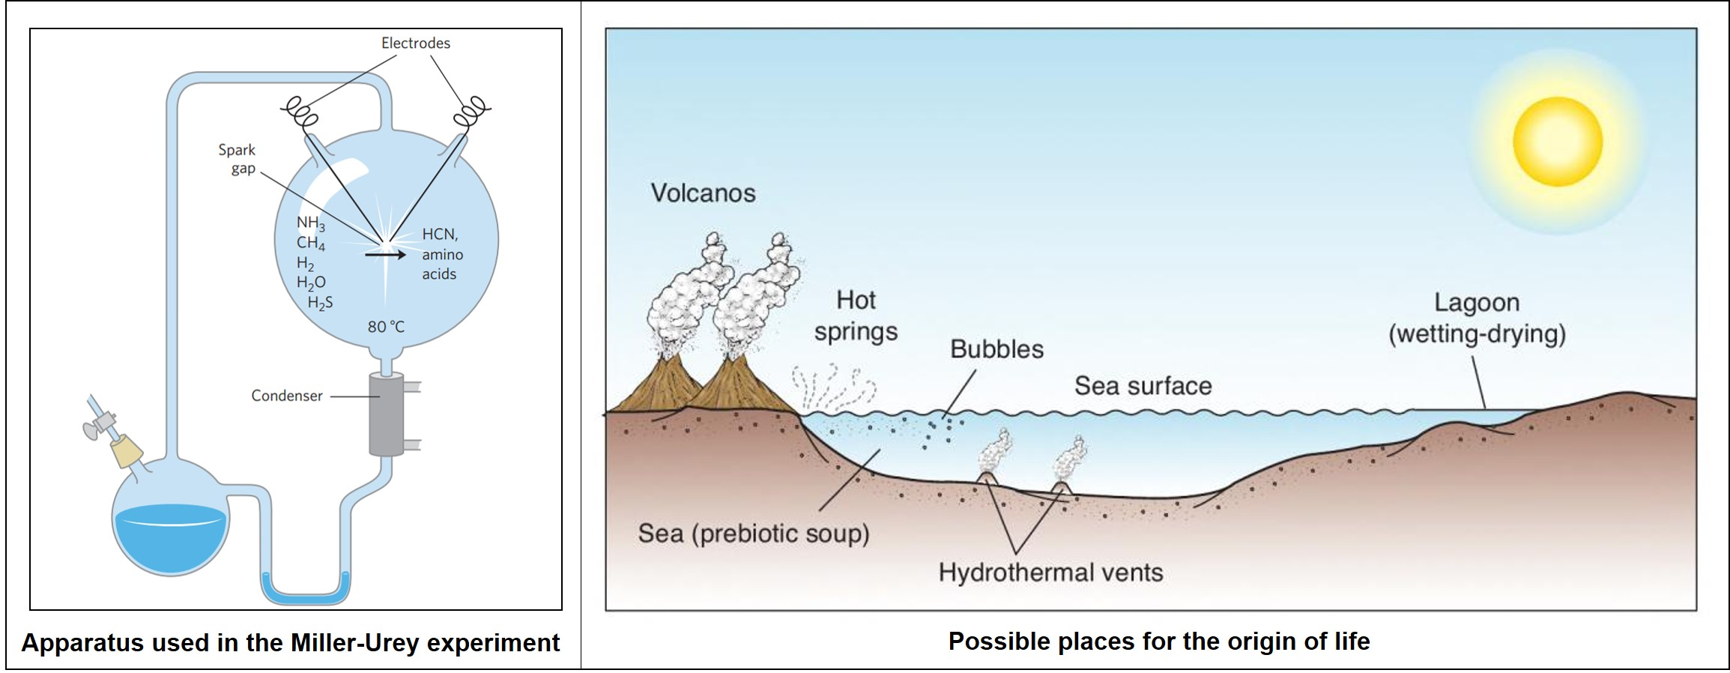
The Miller-Urey experiment

Slide 6
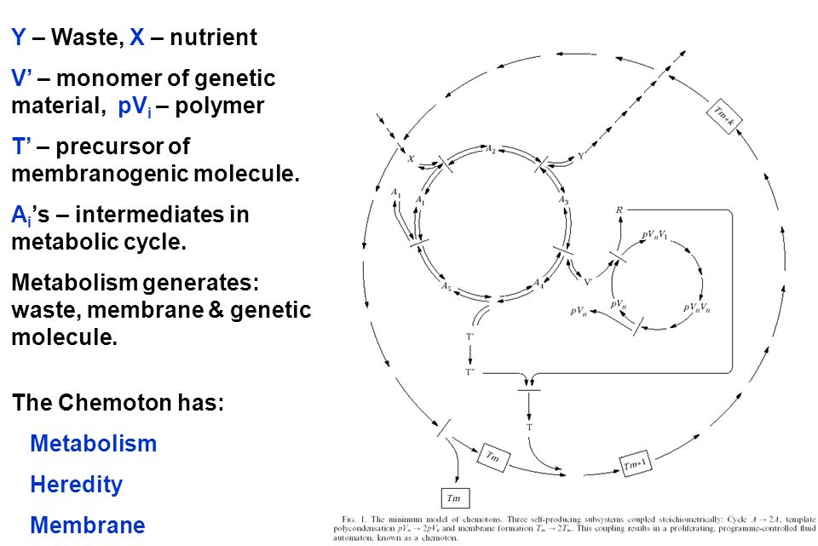
The chemoton
Expelling of waste
Injection of nutrients
Autocatalytic metabolism
Template replication
Membrane formation
Production of membrane precursors

Slide 7
Autopoiesis
“Self-production”
Varela, Maturana emphasize the self-maintenance aspect of living systems, rather than their reproductive capabilities.
Conditions:
Identifiable boundaries
Constructive elements or components
Mechanistic system
Preferential interactions
Boundary components
Inner components

Slide 8
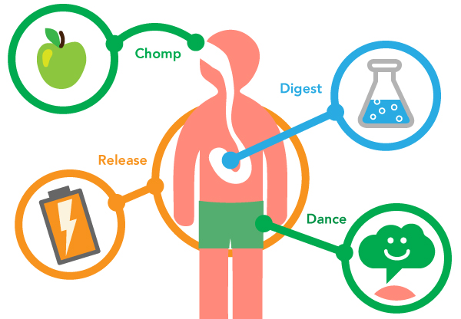
Metabolism

Slide 9
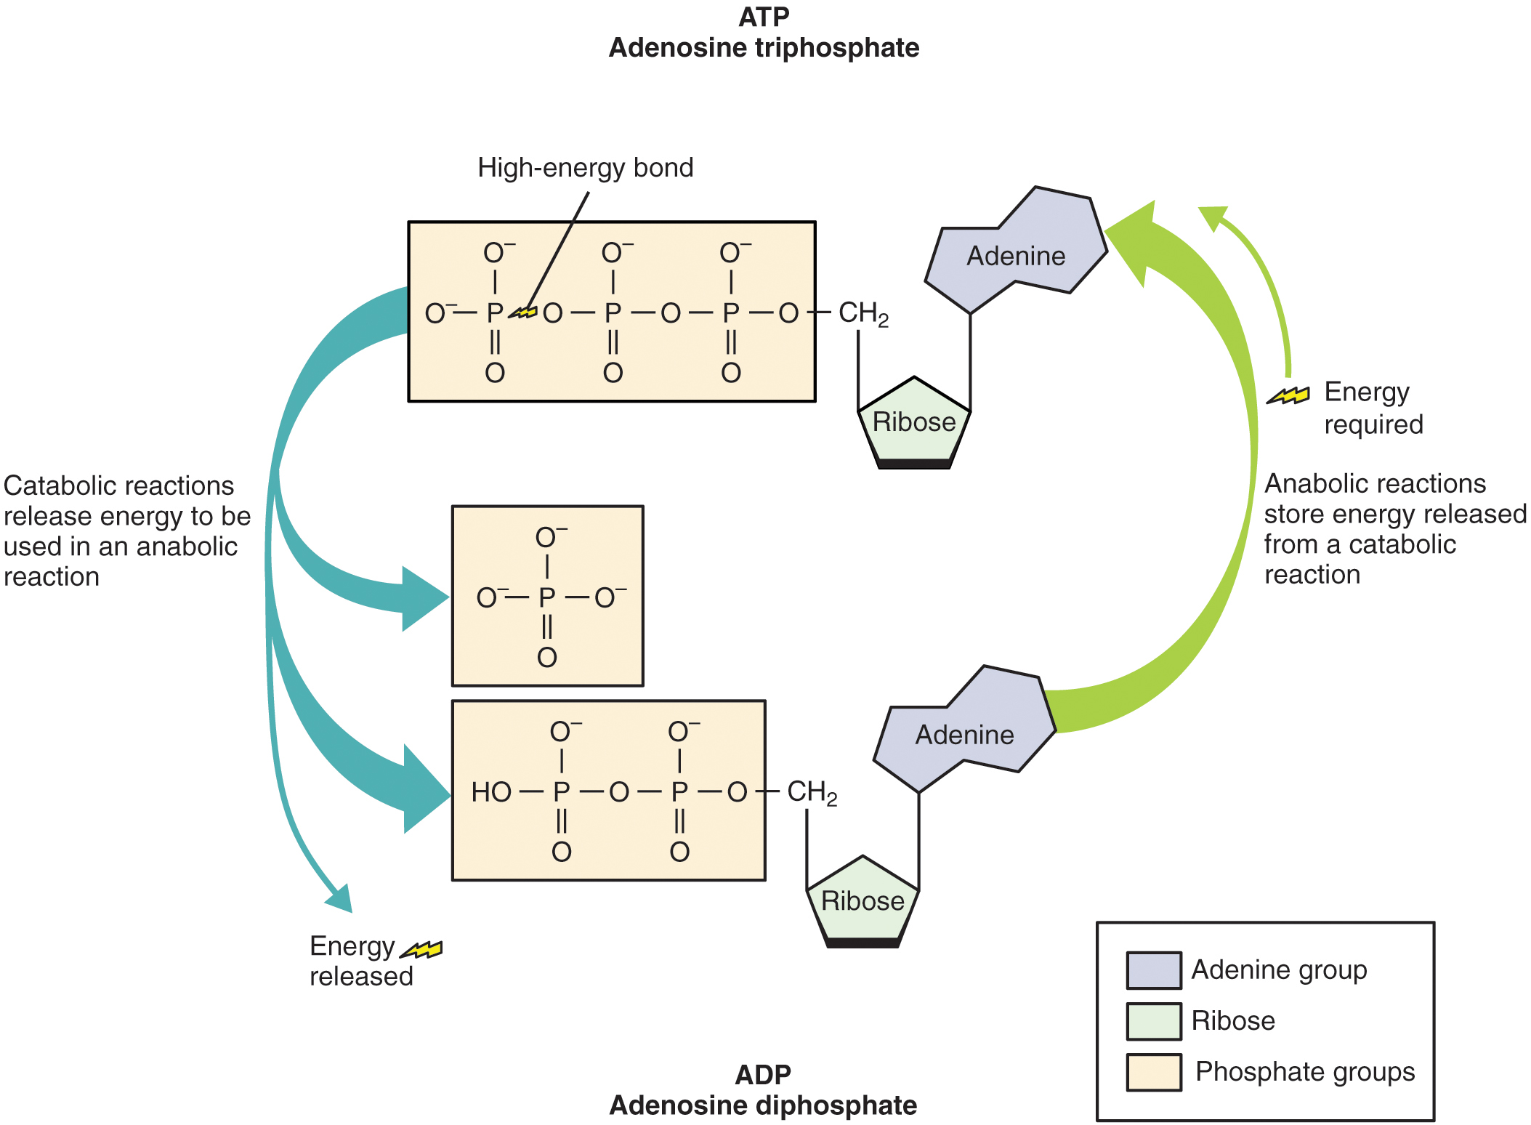
How to get energy?

Slide 10
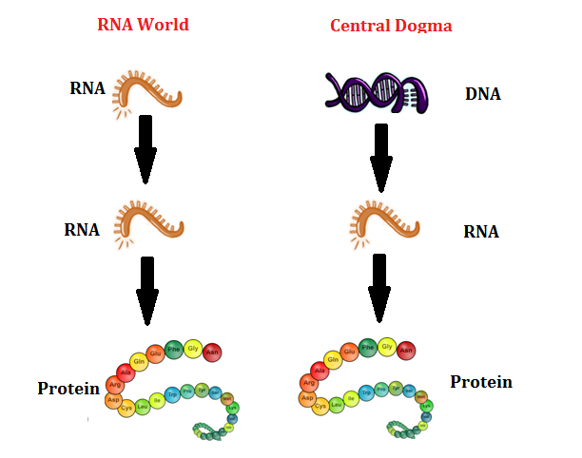
The RNA world

Slide 11
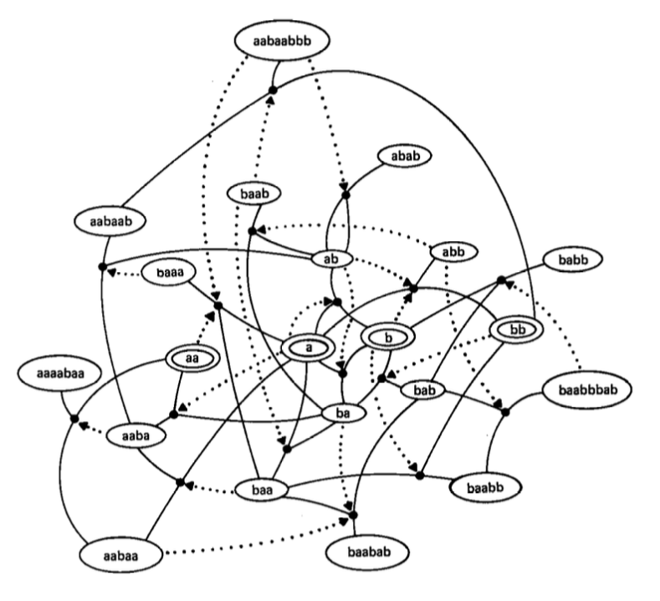
Auto-catalytic sets

Slide 12
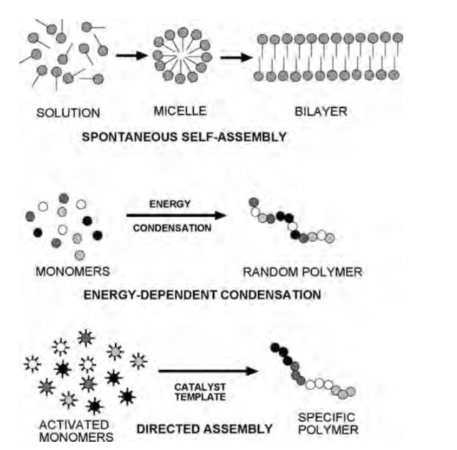
Protocells
Cellular life today uses both self assembly and directed assembly process to grow.
Self-assembly is essential for synthesis and stability of membrane structures and protein folding.

Slide 13
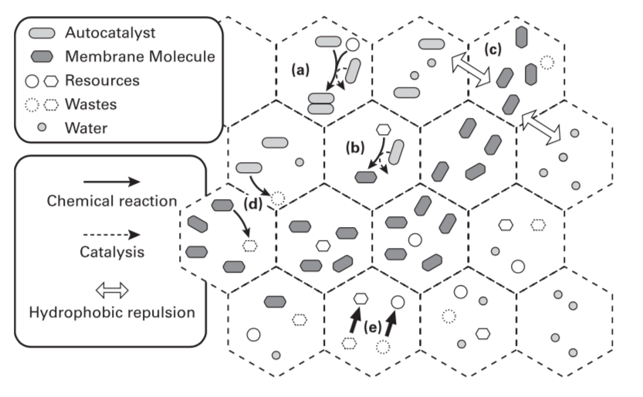
Protocell - Lattice Artificial Chemistry
a) Auto catalysts replicate themselves. b) Some autocatalysts additionally synthesize membrane particles. c) Membrane particles form clusters as a result of the hydrophobic interaction. d) Autocatalysts and membrane particles decay into wastes at a constant rate. e) Resources are supplied by an external driving force that recycles waste into resources uniformly across the space.

